Slide 1
Process data with Spark
Using Hadoop
Alexander Bij

Slide 2
HDInsight Hadoop cluster
Hadoop Ecosystem is bunch of cool open-source projects
  Store & Compute: ZooKeeper + HDFS + YARN + Spark + Tez …
  SQL-related: Hive + Impala + HBase + Druid …
  File formats: ARVO + Parquet + ORC …
Distribution: working combination, manager and support:
  Cloudera
  Hortonworks
  MapR
Azure + Hortonworks + cream = HDInsight
https://docs.microsoft.com/en-us/azure/hdinsight/hdinsight-hadoop-introduction

Slide 3
Spark
Distributed compute engine:
  Fast
  Flexible
  General purpose
  Easy to use
ETL with code batch & streaming
  Scala (native)
  Java
  Python & R

Slide 4
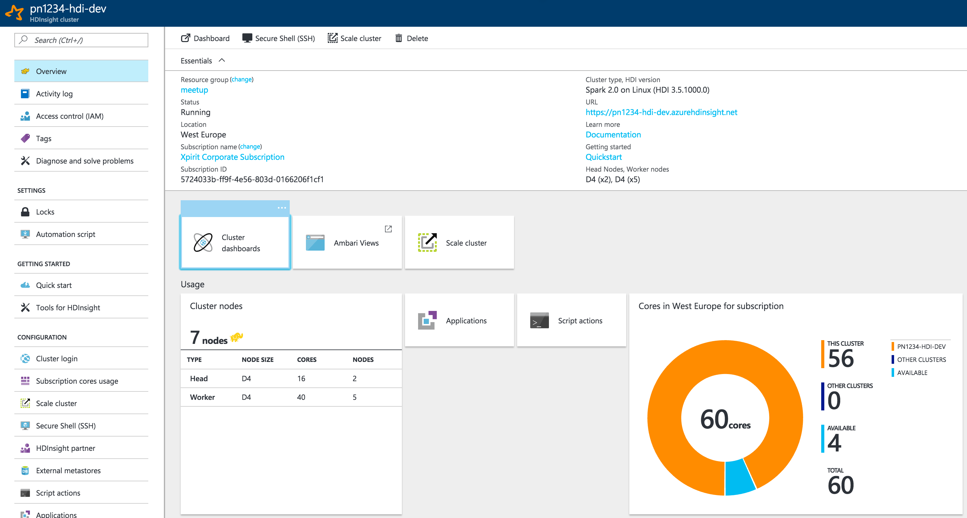

Slide 5
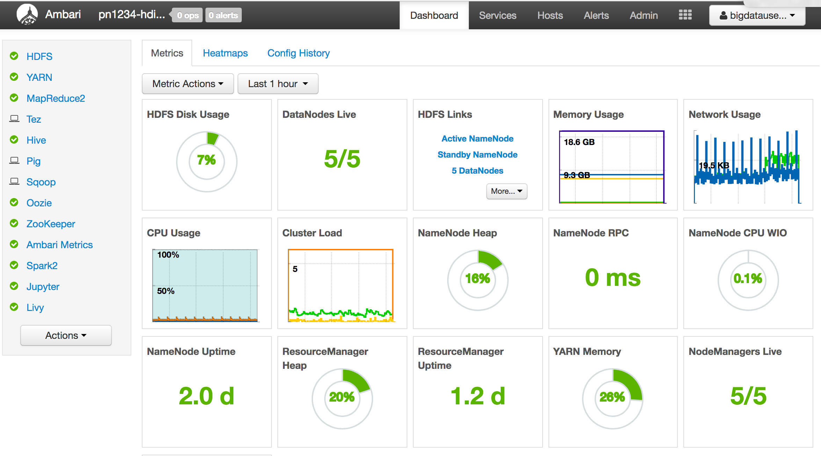

Slide 6
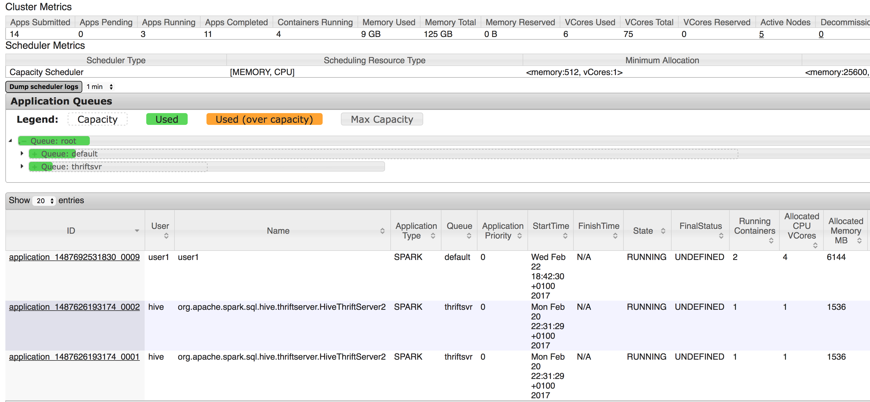

Slide 7
Our extra flavor
Extra GatewayNode: meetup-custom-gateway
  IaaS – Ubuntu VM
    Post-installed with Ansible
    Synced with HDInsight - headnode
  Miniconda3 python environment
  JupyterHub (interactive notebook)
  Multi-user accounts (local accounts)
  Configured for specific needs…

Slide 8
Our goal
Work with an interactive notebook
Access your generated data using hdfs
Load AVRO-files in a Spark DataFrame with Python code
Basic ETL-transformations
Plot data inside notebook
Use Spark SQL to query data

Slide 9
Have fun
https://github.com/DutchAzureMeetup/BigDataIngestion2
  labs\2-Hdinsight
README with instructions
  Each step has a reference to the docs.
  Feel free to ask questions
Folder solutions contains a fully working notebook example

